Slide 1

ICA
Titusville & Horsham

Slide 2
Meet the Team

Slide 3
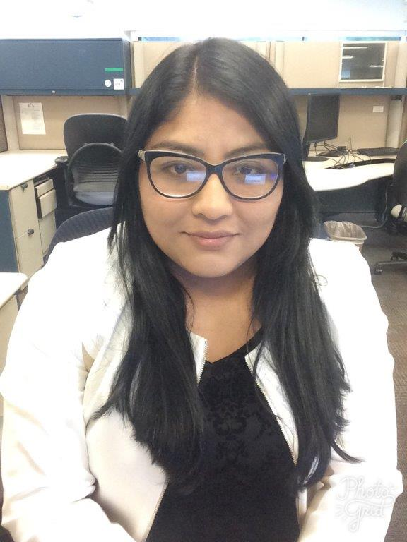
LESLY SERRANO
PRESIDENT
Hometown: Paterson, NJ
School: New Jersey Institute of Technology
Major: Chemical Engineering
Previous work experience: Global Transportation Supply Chain IT at Johnson & Johnson
Current Position: IT Pharma Collaboration and Productivity Summer Intern
Work Location: Titusville , NJ

Slide 4
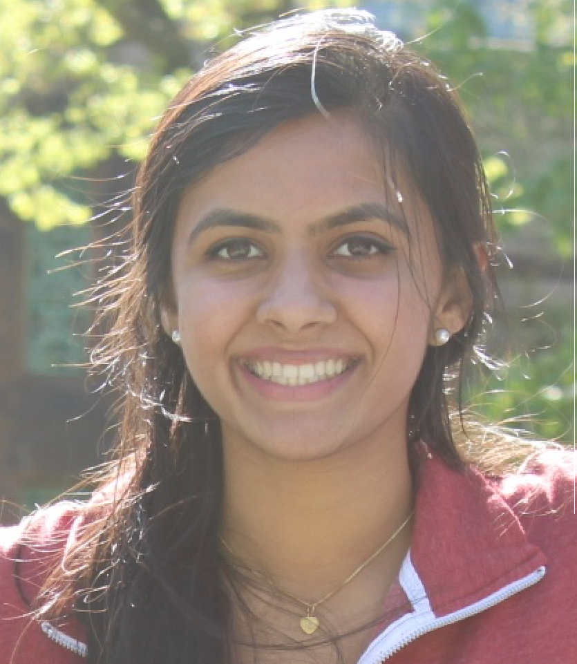
SNEHA RAMPALLI
TECH. & COMM. CHAIR
Hometown: Princeton, NJ
School: University of Pennsylvania
Major: Computer Science
Previous work experience: Production Assistant at the Wharton Business Radio Sirius XM
Current Position: IT Pharma Collaboration and Productivity Summer Intern
Work Location: Titusville , NJ

Slide 5
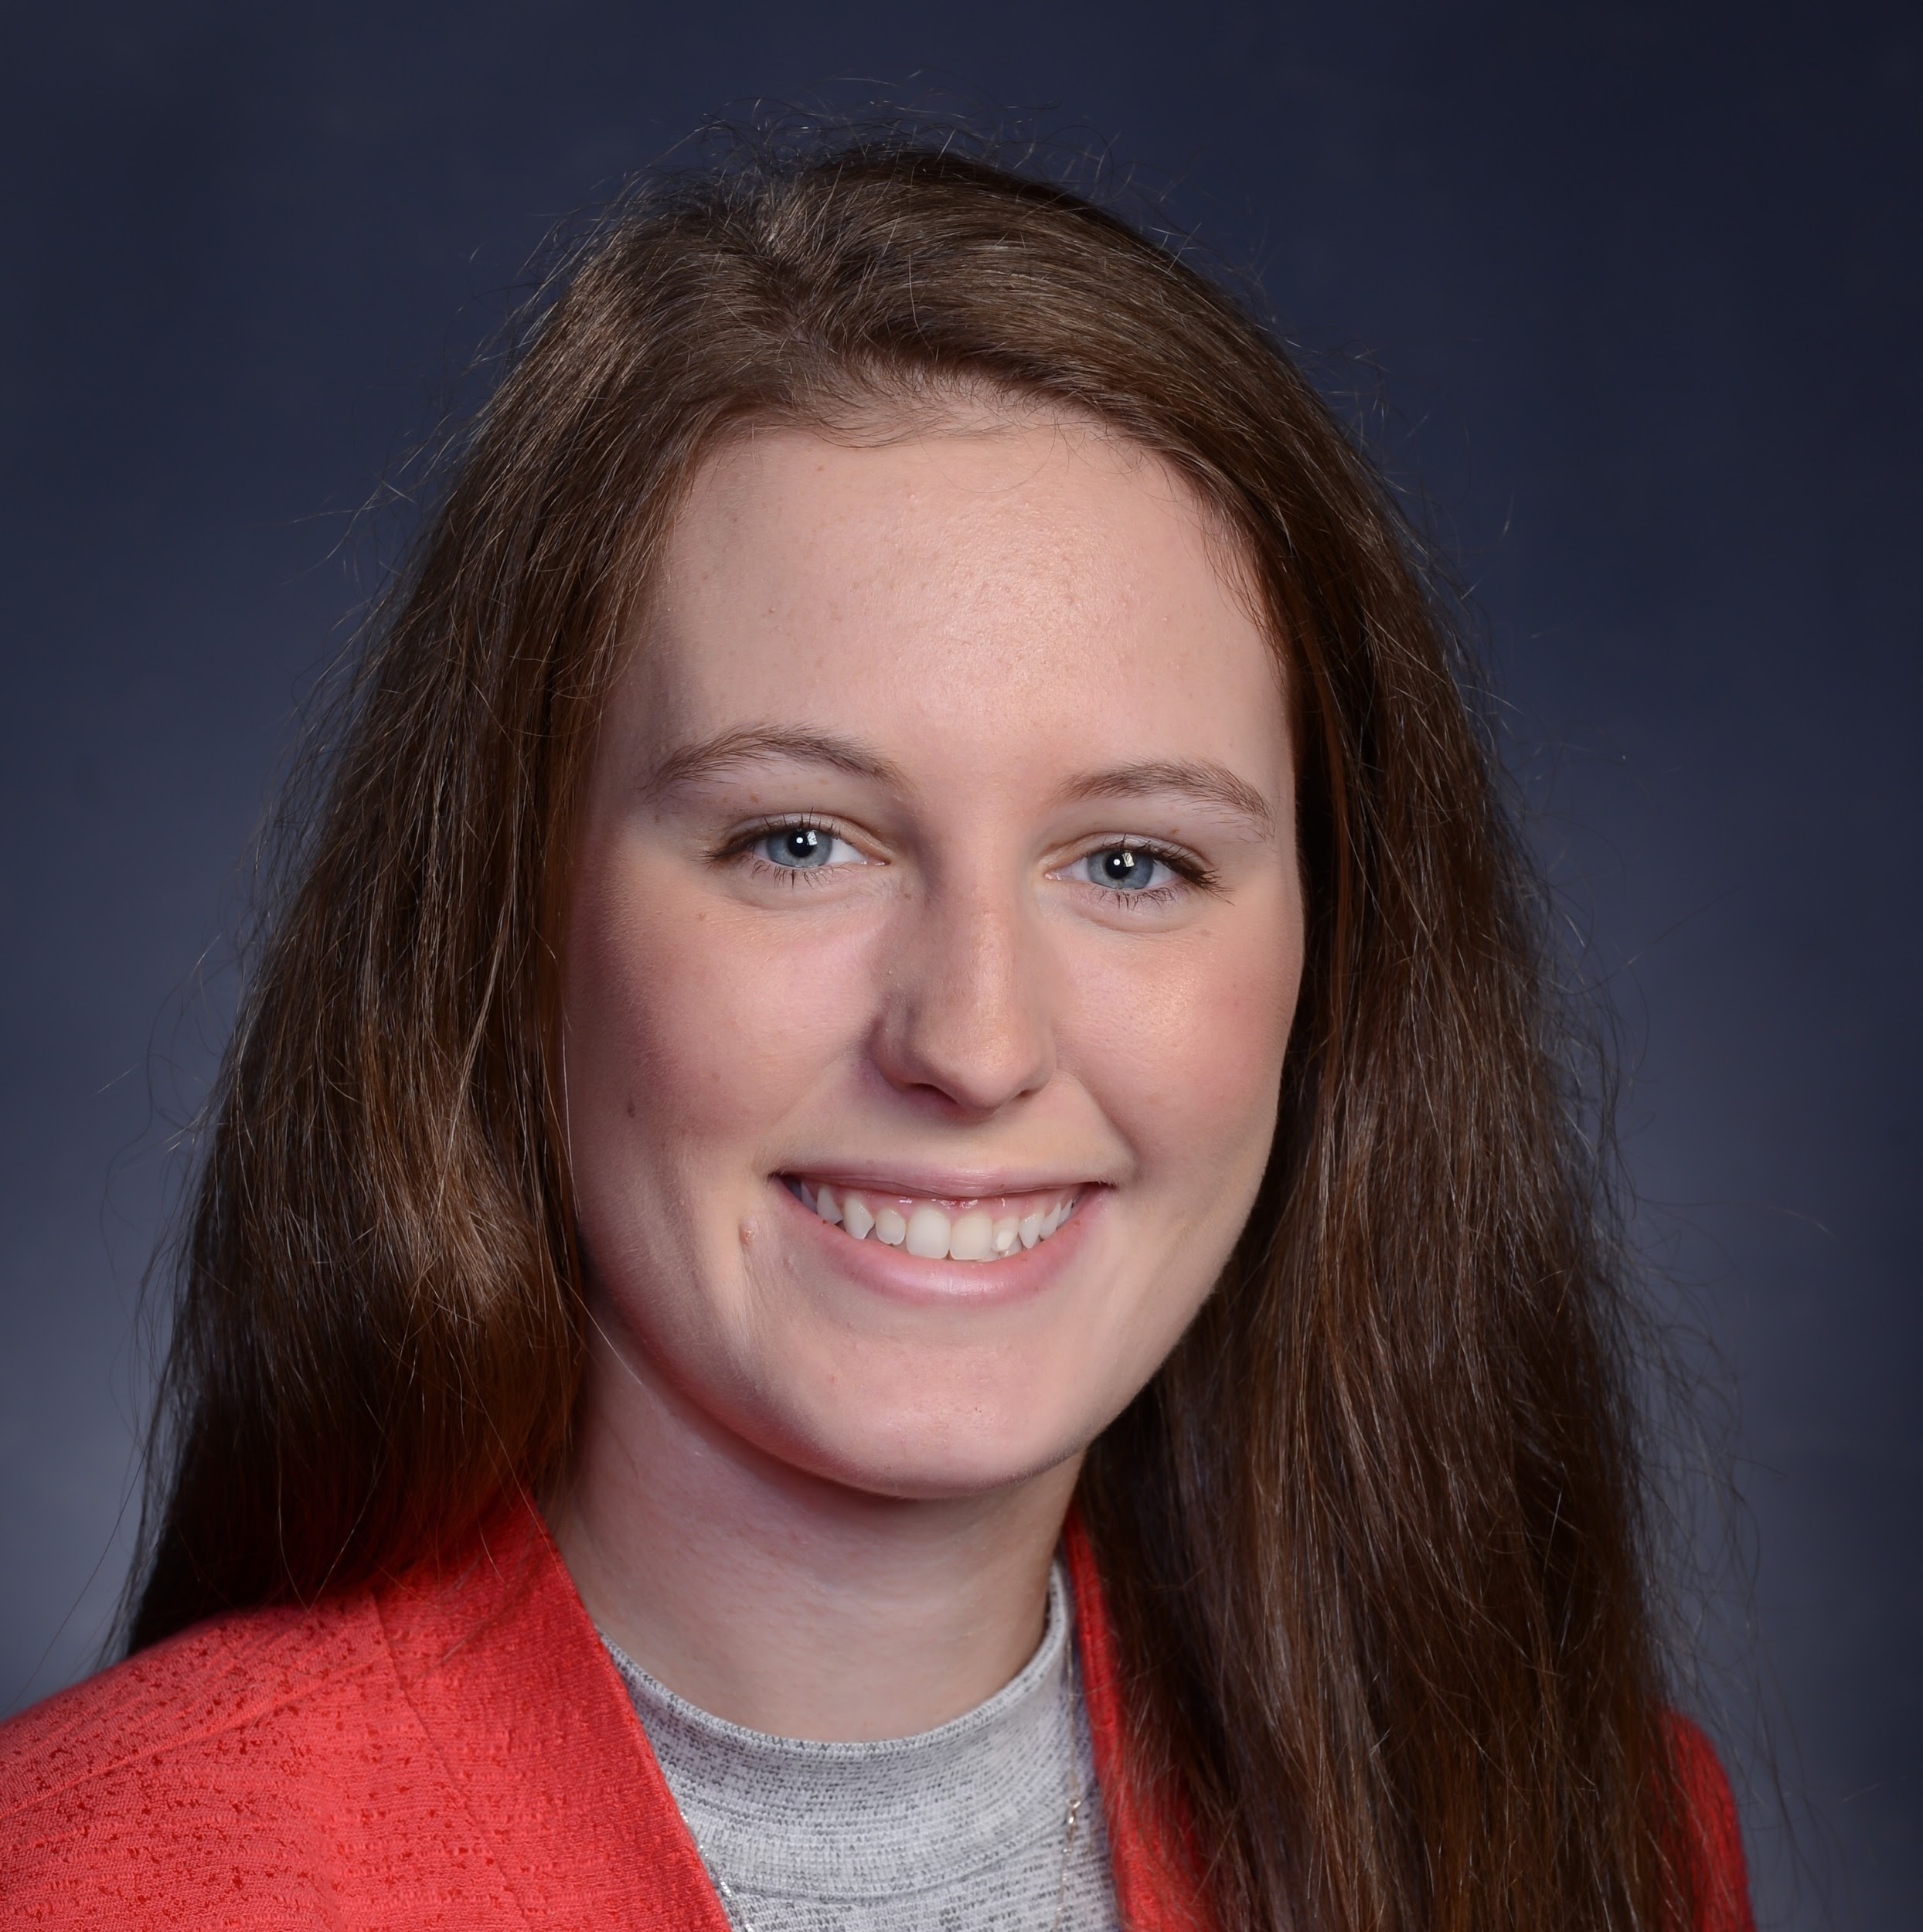
JENNA SLUSAR
COMM. SERVICE & EVENT PLANNING CHAIR
Hometown: Annandale, NJ
School: Bucknell University
Major: Computer Science, Italian
Previous work experience: Software Development Intern at Performline
Current Position: IT Pharma Collaboration and Productivity Summer Intern
Work Location: Titusville

Slide 6

JORDAN HAGERTY
SOCIAL NETWORKING CHAIR
Hometown: Horsham, PA
School: La Salle University
Major: Integrated Science Business and Technology
Previous work experience: First internship
Current Position: IT Pharma Collaboration and Productivity Summer Intern
Work Location: Horsham, PA

Slide 7
Opportunities in the ICA
RESUME BUILDING
NETWORKING
OPPORTUNITIES
COMMUNITY SERVICE
APPLY FOR OFFICER POSITIONS

Slide 8
Available Position
Professional Development Chair:
Plans and coordinates activities designed to enrich the professional growth and knowledge of members
Responsible for developing workshops (e.g.: Resume building)
Networking opportunities with interns across JNJ

Slide 9

WEBSITE
https://icajnj.github.io/icajnj

Slide 10

ICA: Meet the Advisors

Slide 11

Career Development: Rusty Moke

Slide 12

Community Service Events:
Trenton Area Soup Kitchen

Slide 13

Stony Brook-Millstone Watershed

Slide 14

Tentative Community Service Event
8 volunteers max assistance to assemble pouches of food for the Send Hunger Packing program 9am to Noon, or for sorting any donated food that comes in.
We also need physical help loading vehicles as well.
August 2,3,30,31 September 14 Oct 4, 12, 18, 25, 26 November 2 December 6,7

Slide 15
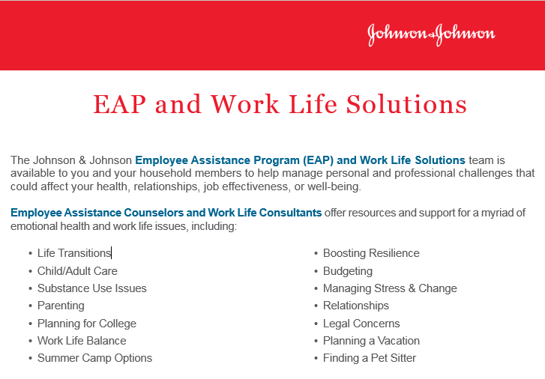
Employee Assistance Program (EAP) and Work Life Solutions

Slide 16
Thank you very much for your time!
If you have any questions about this document please don’t hesitate to contact us at:
https://icajnj.github.io/icajnj
icajnj@gmail.com

Slide 17
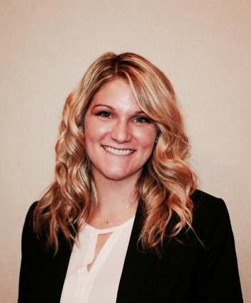
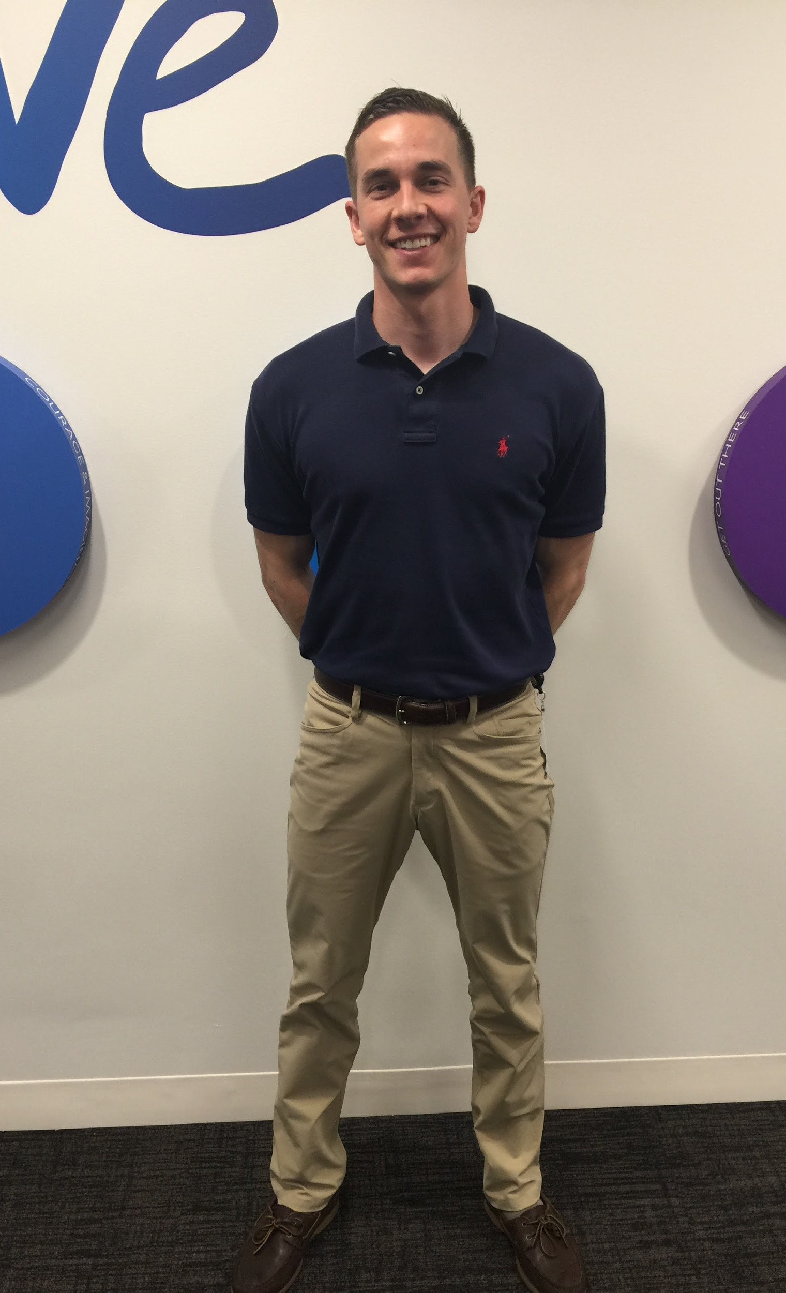

SPECIAL THANKS TO ALL OF OUR ADVISORS...
CHRISTINE KEENEY
DAVID LOVECCHIO
ALEXANDRA RUSSOMANO

